Slide 1

- Project Title - Car Market Trends Analysis
- AICTE Student ID - STU6824a302c0a571747231490
Internship ID :
INTERNSHIP_17830691666a4779eecfe8a
- Student Name –
TUMMALA SASI VARDHAN

Slide 2

PROBLEM STATEMENT
The used-car market contains vehicle information such as manufacturing year, selling price, present price, kilometers driven, fuel type, seller type, transmission and ownership. However, the raw dataset does not directly reveal how these factors influence vehicle prices, depreciation and market demand. Without systematic analysis, it is difficult to identify pricing patterns, compare different vehicle categories and understand the characteristics of the used-car market. Therefore, the problem is to analyse the Car Dekho dataset using Python and data analysis techniques to extract meaningful insights and identify the key factors affecting used-vehicle prices and depreciation.

Slide 3
Project Description
Car Market Trends Analysis is a Python-based data analysis project using the Car Dekho free dataset. The project involves loading and examining the dataset, checking for missing values, analysing vehicle prices, identifying the most frequently sold vehicles, studying fuel type, seller type, transmission and ownership patterns, and analysing vehicle depreciation. The project also separates two-wheelers and cars to identify the oldest, newest and most sold vehicles in each category. The analysis is performed using Pandas,Numpy and other Python libraries in Google Colab.

Slide 4

WHO ARE THE END USERS? > Used-Car Buyers – Compare vehicle prices, age and mileage. > Car Dealers – Understand selling prices and depreciation trends. > Vehicle Sellers – Estimate reasonable selling prices. > Automotive Businesses – Analyse market patterns and vehicle demand. > Data Analysts / Students – Study real-world vehicle-market data using Python.

Slide 5

Technology Used
Programming Language
Python
Libraries
Pandas
NumPy
Matplotlib
Seaborn
Development Platform
Google Colab
Dataset
Car Dekho Vehicle free Dataset

Slide 6
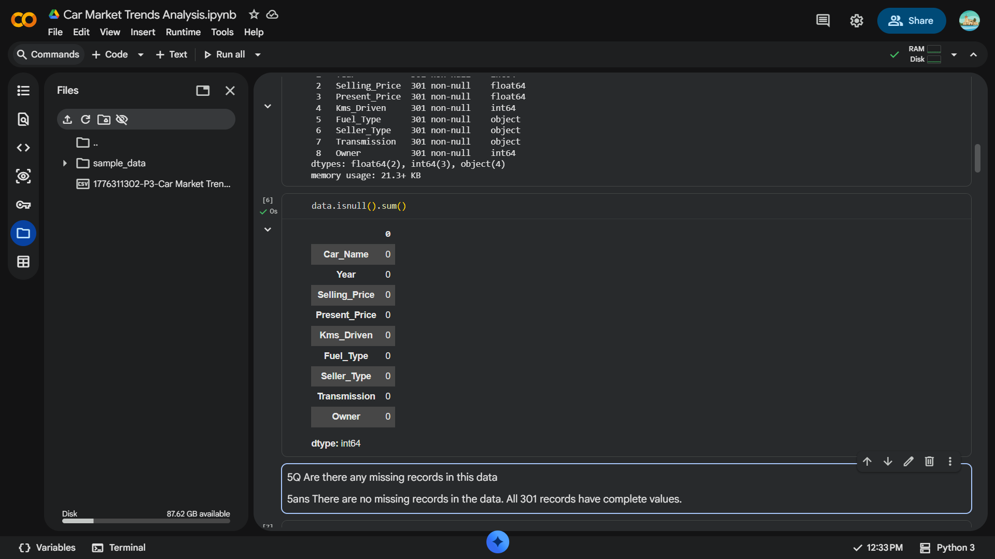
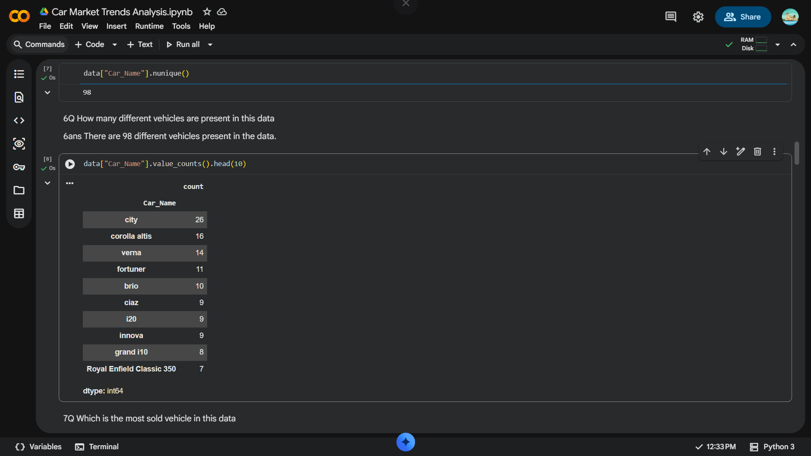
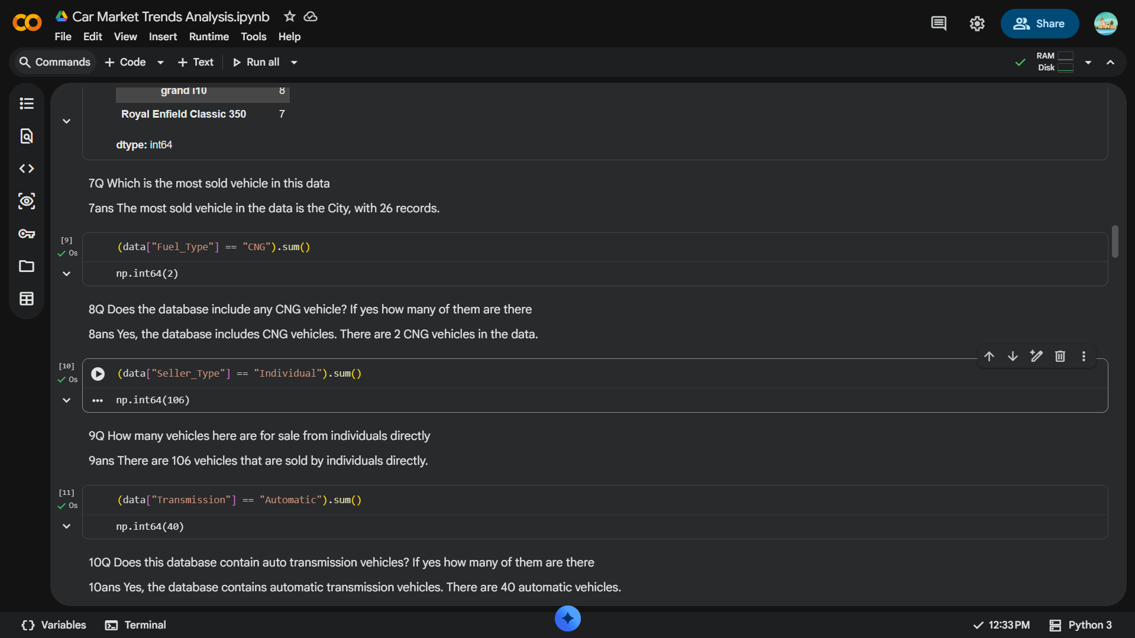
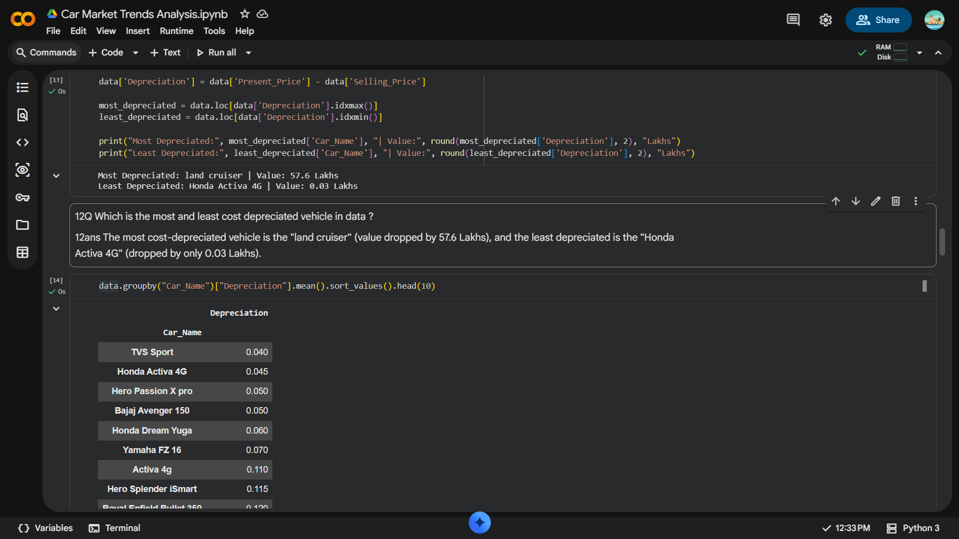
RESULTS

Slide 7
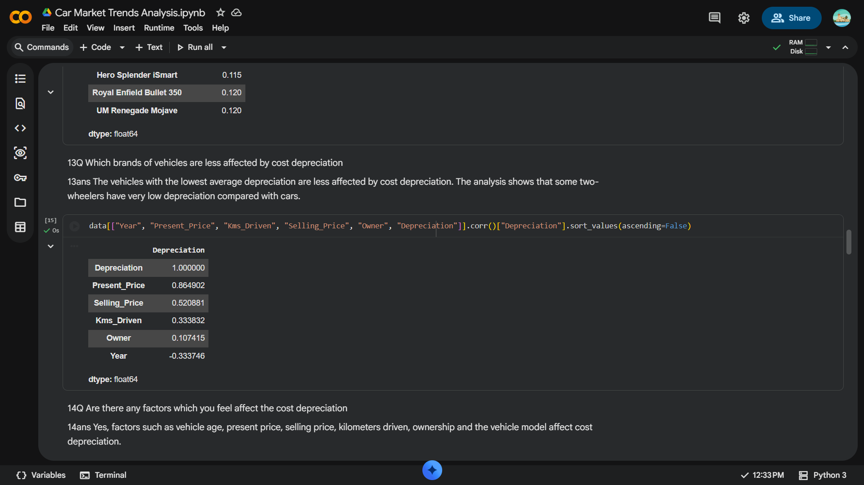
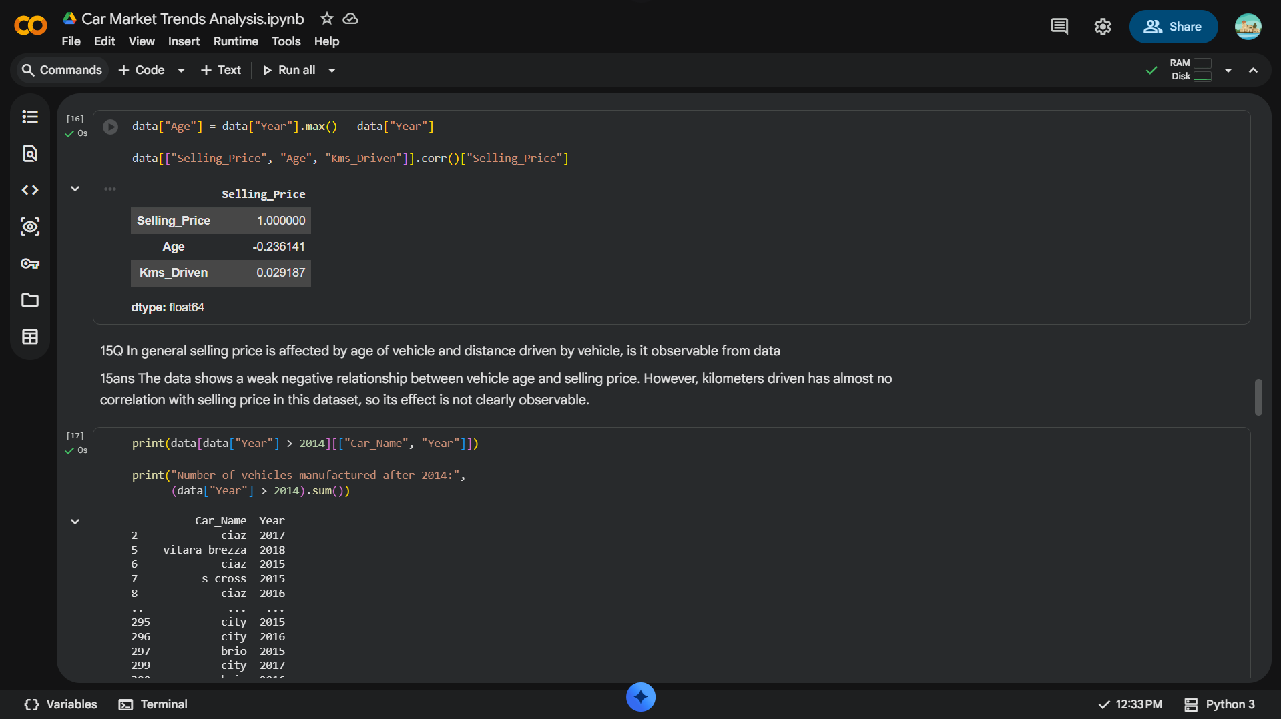
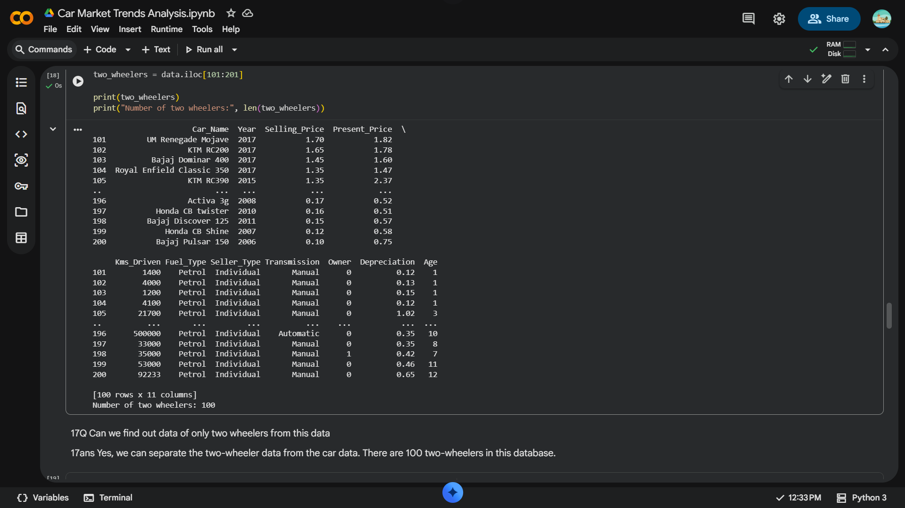
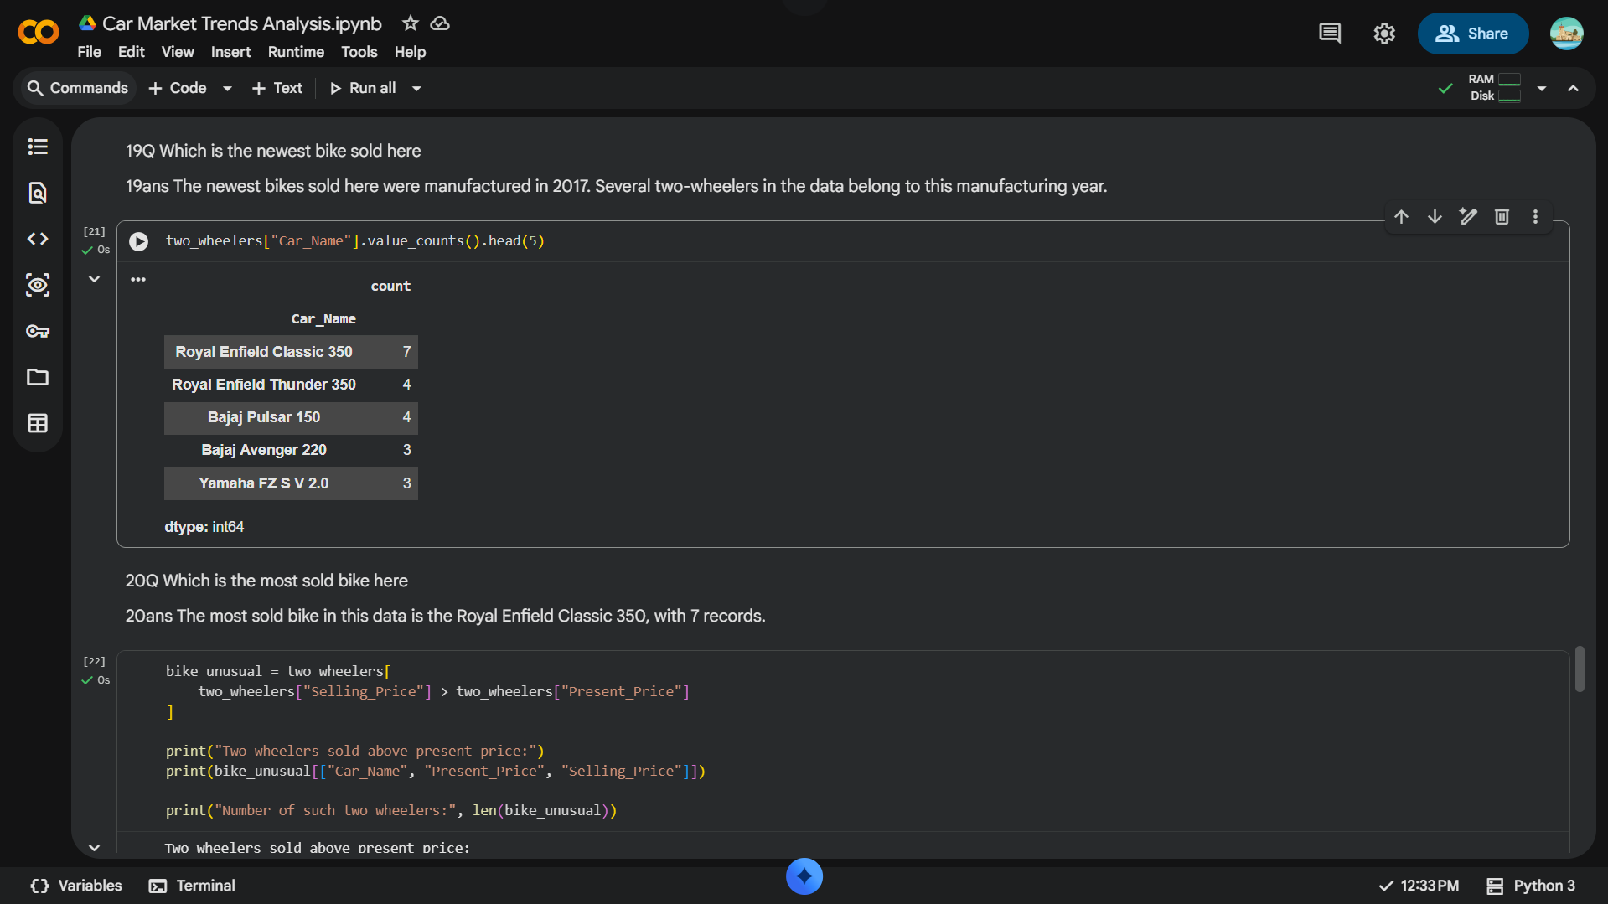
RESULTS

Slide 8
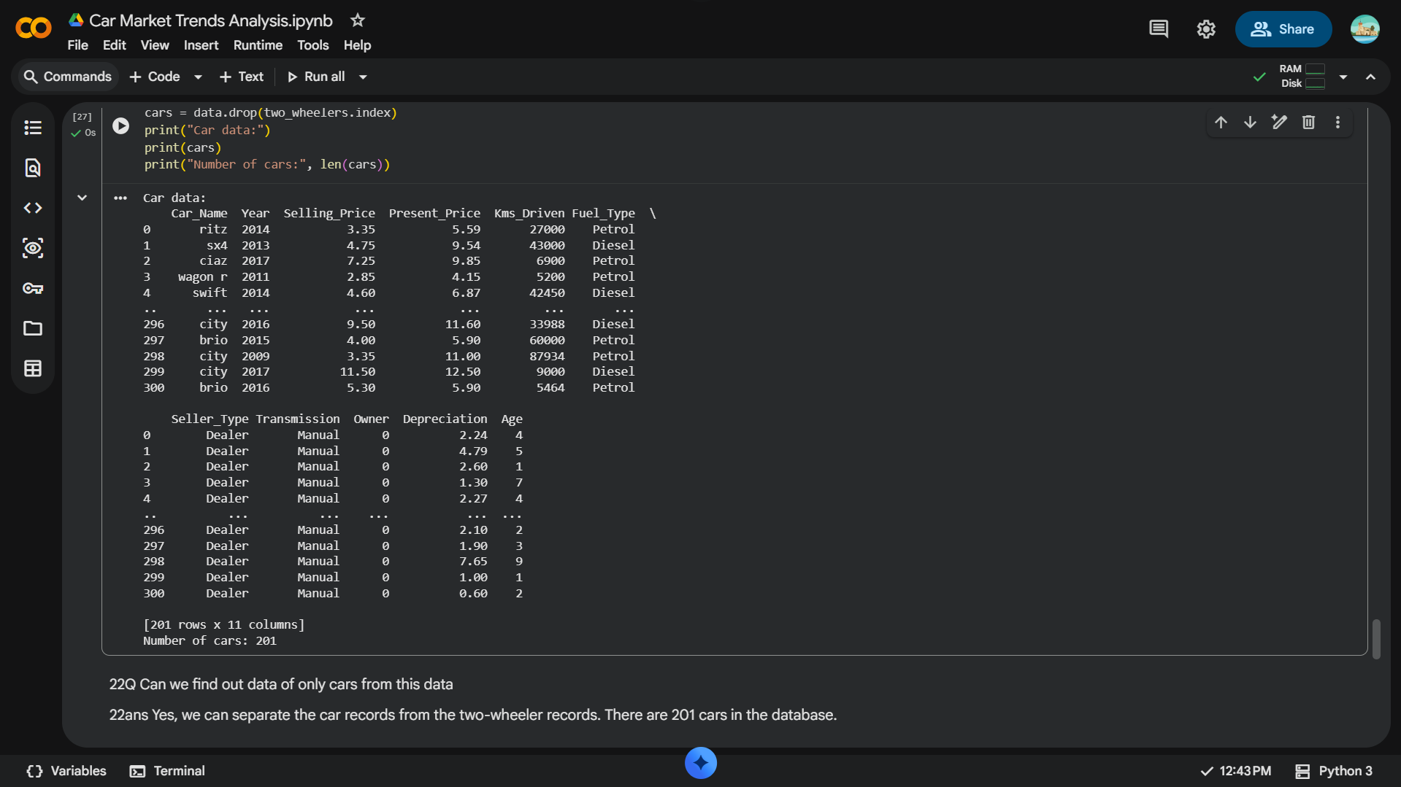
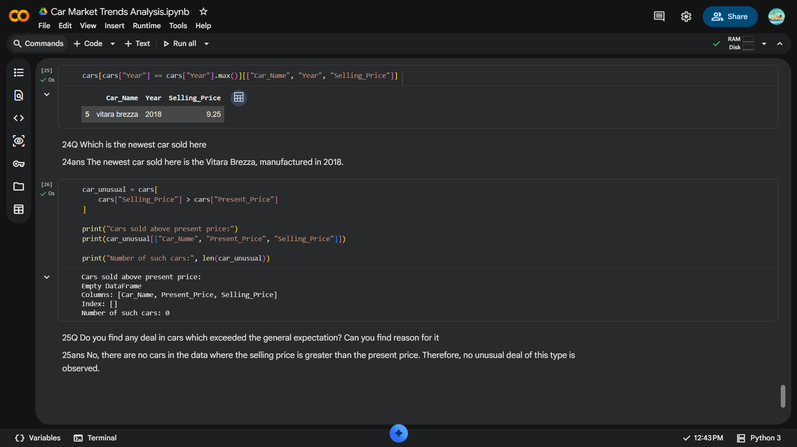
RESULTS
Demo link:

Slide 9
& Thank you
- Conclusion -
Through this project, the Car Dekho dataset was analysed using Python to understand important trends in the used-vehicle market. The analysis identified vehicle price ranges, missing values, popular vehicles, fuel types, seller types, transmission types and ownership patterns. Depreciation analysis helped identify vehicles with the highest and lowest price depreciation. The dataset was also separated into two-wheelers and cars to study their individual characteristics. Overall, the project demonstrates how data analysis can be used to extract meaningful insights from real-world vehicle-market data.

